Slide 1
Project Z
Outdoor game on android

Slide 2
Summary
Team introduction
Project
Features
WBS & gantt
BurnDown
Mockup
Personnas
Epic story
Test cases
Q&A

Slide 3
Team
Mustapha Moussaab Aouas 16129175
Le Hoang-Du 16129107
Xu Alexandre 16129123
Force Kévin Quentin Morgan 16129138
Amriche Sami 16129155

Slide 4
Project
It’s an android game : the user will create his/her hero and will dwell on the surface of this earth forever searching the Dragon Balls. The dragon balls will helps the player to up his/her stats and therefor helps him to win the fights.
Our users will be the teenagers, also the young mens and all the dragon ball lovers, whom like to go outside to play alone or with some friends when the weather is good.
The game will take place in the big citys. Every city will have it’s 7 dragon balls.

Slide 5
Features
The app will use the following features :
GPS
NFC
AR
Sensors
Network
Camera
Map

Slide 6
Technologies
Unity
Android Studio
wamp
Java , C#, php, Mysql, xml
Google Map API
Kudan AR library

Slide 7
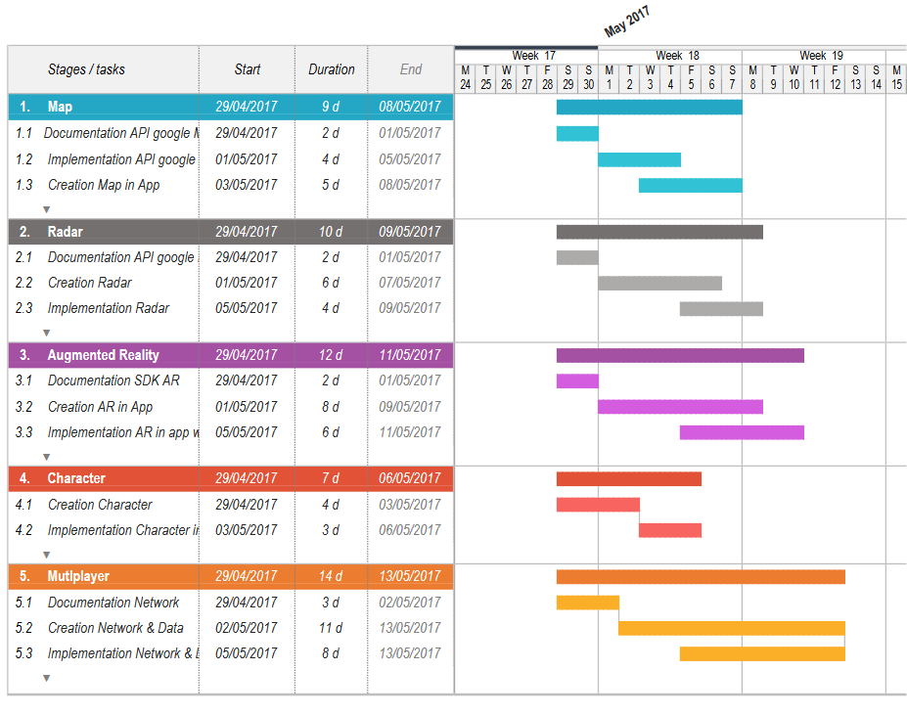
gantt

Slide 8
Radar & Map Creation
Radar & Map
implementation
documentation
Character Creation
Settings
Test
Google Map implementation
AR Implementation
Player & Object Location
Multiplayer

Slide 9
Thank you for listening

Slide 10
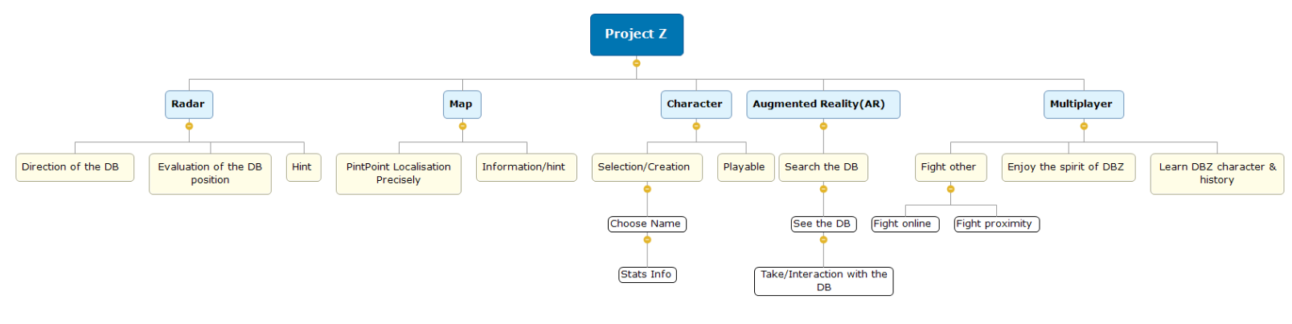
WBS

Slide 11
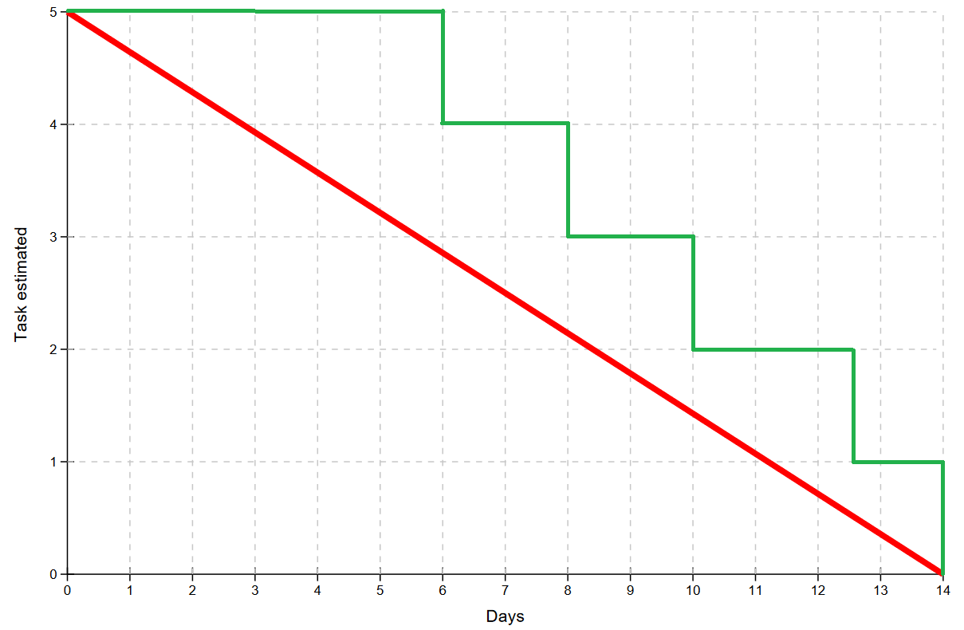
burndown

Slide 12
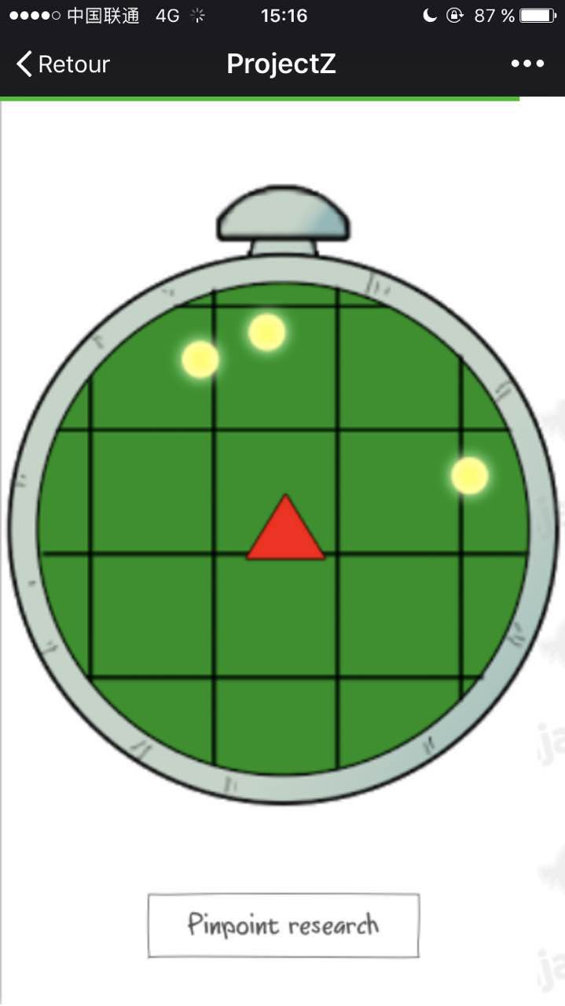
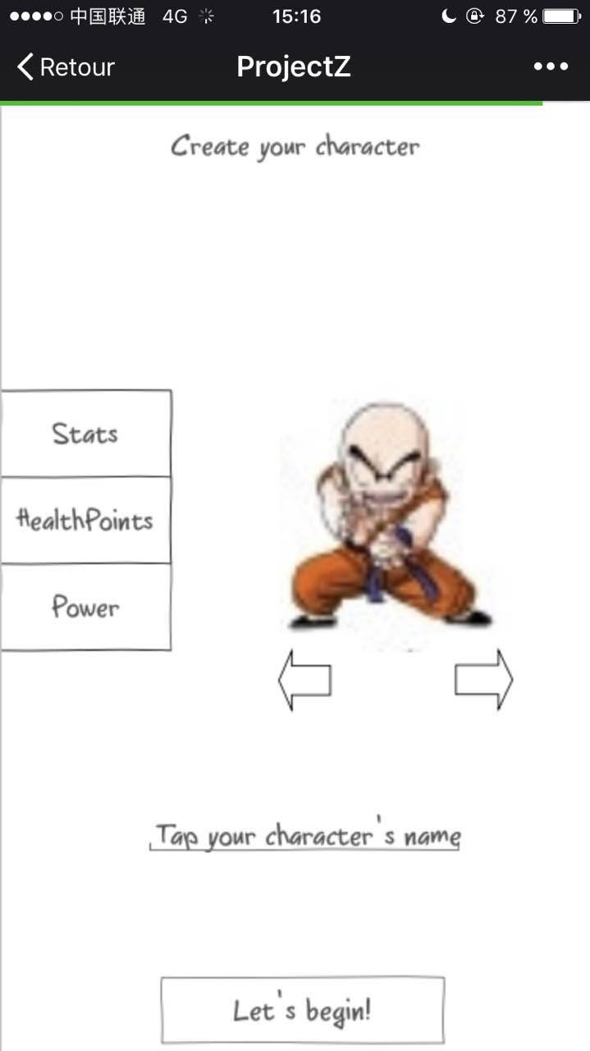
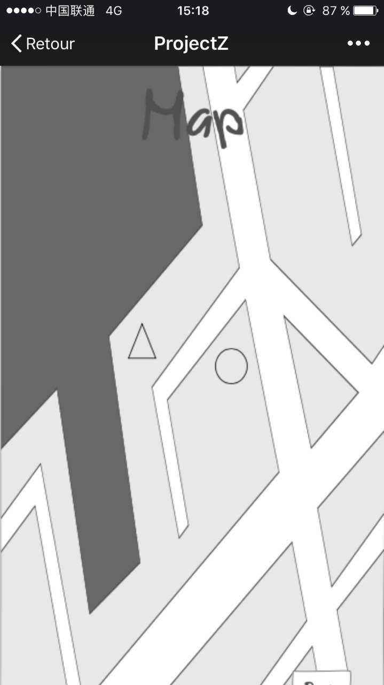
Mockup

Slide 13
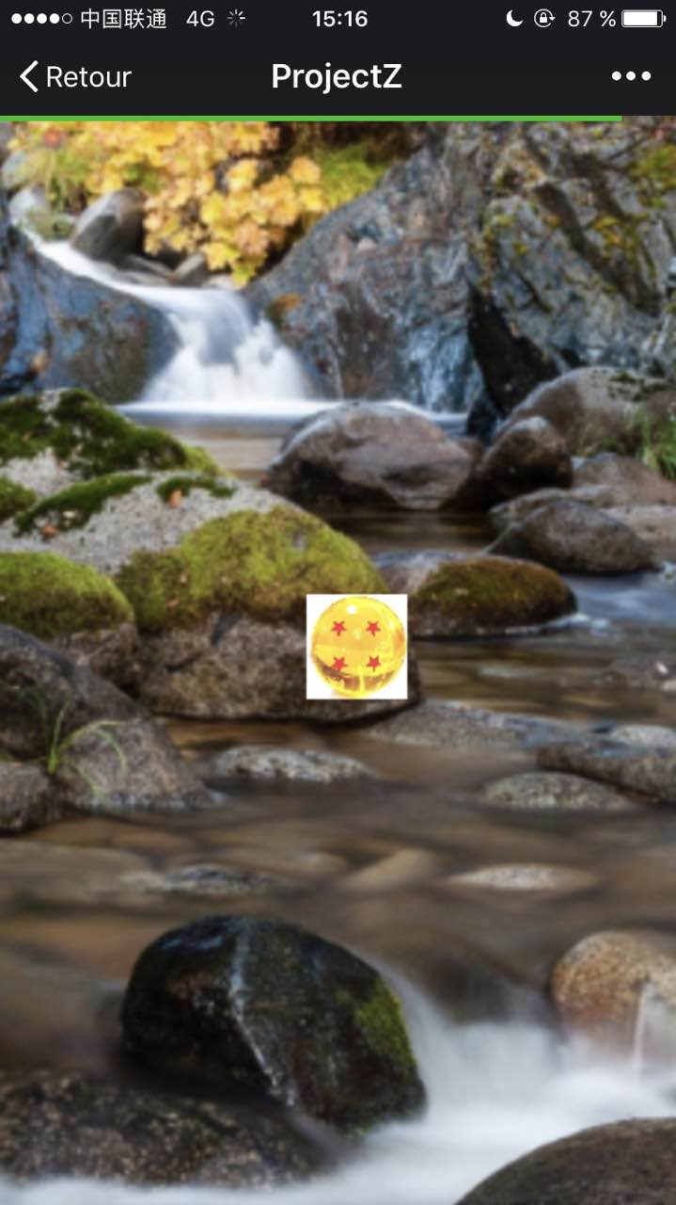
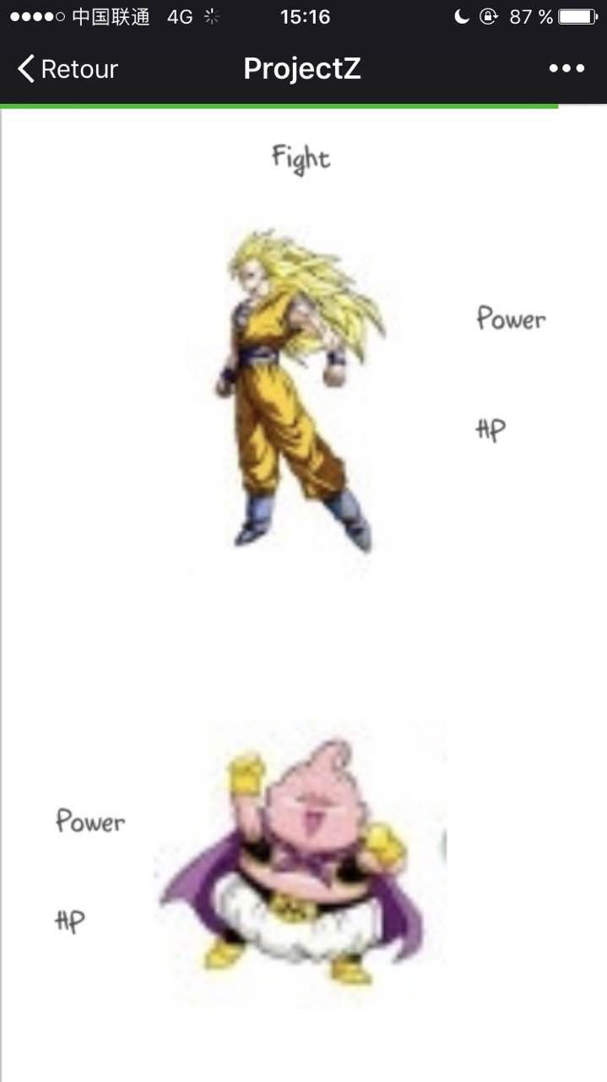
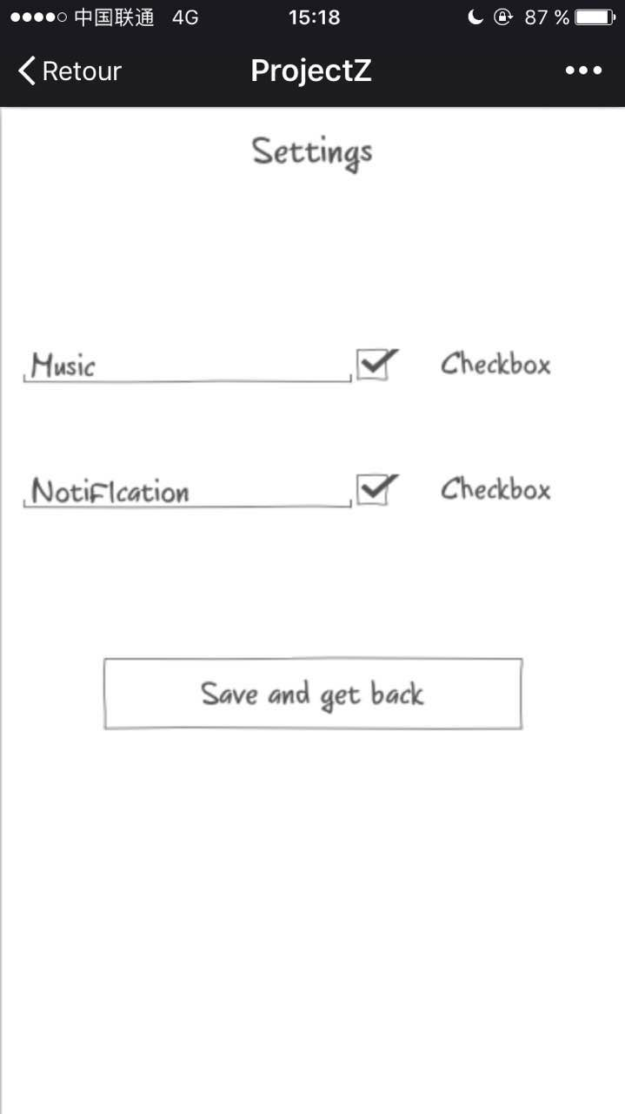
MOKUP

Slide 14
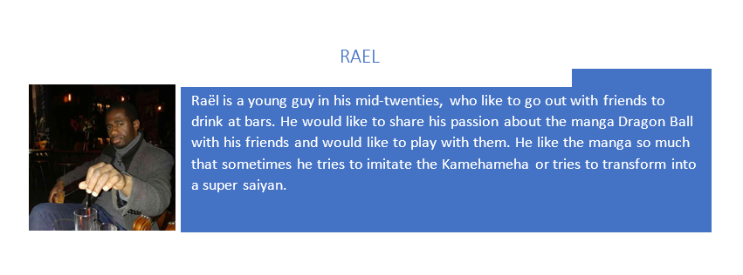
Personna

Slide 15
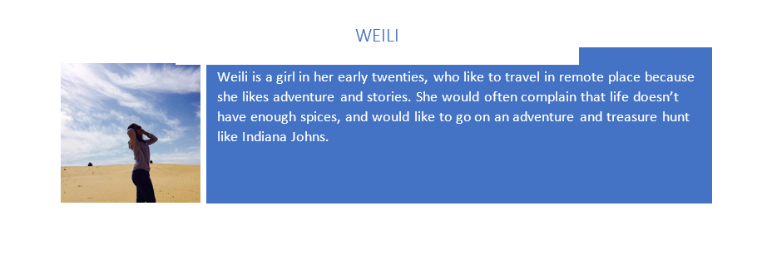
PERSONNA

Slide 16
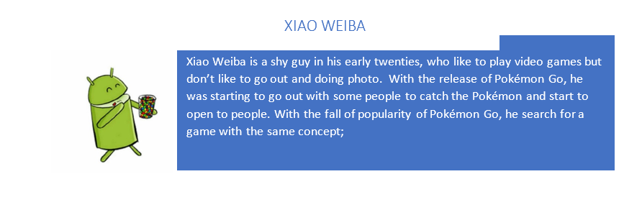
PERSONNA

Slide 17
Epic story
Epic Title: Radar.
Epic Description: As Rael is a fan of Dragon Ball, he wants to find the Dragon Ball. Rael can walk through the world and try to locate the Dragon Ball
US1 : Rael appears in the game, not moving, just like any other moveless element.
US2 : Rael begins to move through the world, without any special destination.
US3 : Rael locates a Dragon Ball.
US4 : Rael goes in the good direction to find it.
US5 : Rael needs to walk or take a bike to go to the location.
US6 : Rael can stop walking.
US7 : Rael is aware of everything around him and must be careful with his environment.

Slide 18
Epic story
Epic Title: Fight.
Epic Description: As Weili is a fan of Dragon Ball, she wants to find the Dragon Ball but someone finds the Dragon Ball before her so she fights him for the treasure.
US1 : Weili finds a dragon ball on the radar.
US2 : She goes directly to the location.
US3 : She finds someone find it before her.
US4 : She uses the application to fight for the dragon ball.
US5 : Weili is a beginner and she’s in front of an old player.
US6 : Weili looses.
US7 : She didn’t manage to get this dragon ball.
US8 : She detects another dragon ball so she can have another try at it.

Slide 19
Epic story
Epic Title: Character.
Epic Description: As xiao weiba begins to play to the game, he open for the first time the game and so need to create a character.
US1 : Xiao weiba opens the application.
US2 : He directly creates his character.
US3 : He can only begin with the Bald one.
US4 : He is sad but he knows he can change after.
US5 : He checks the stats of Kirilin.
US6 : He is disappointed.
US7 : He begins to search the dragon ball to improve his character and to change it afterwards when it’s possible.

Slide 20
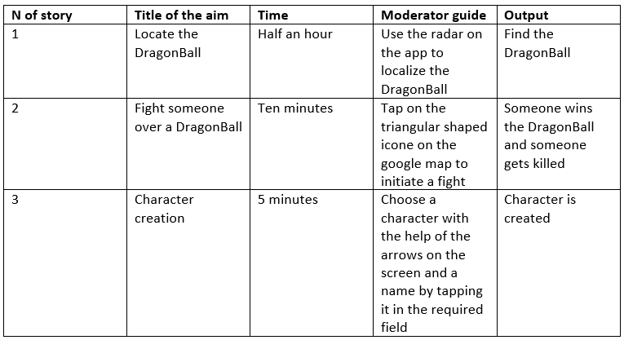
Test cases

